Slide 1
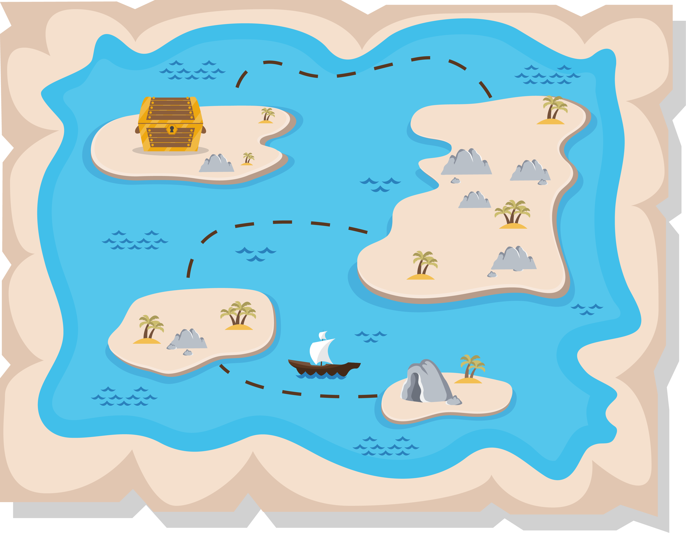
Lesson 2:
Treasure Hunt

Slide 2
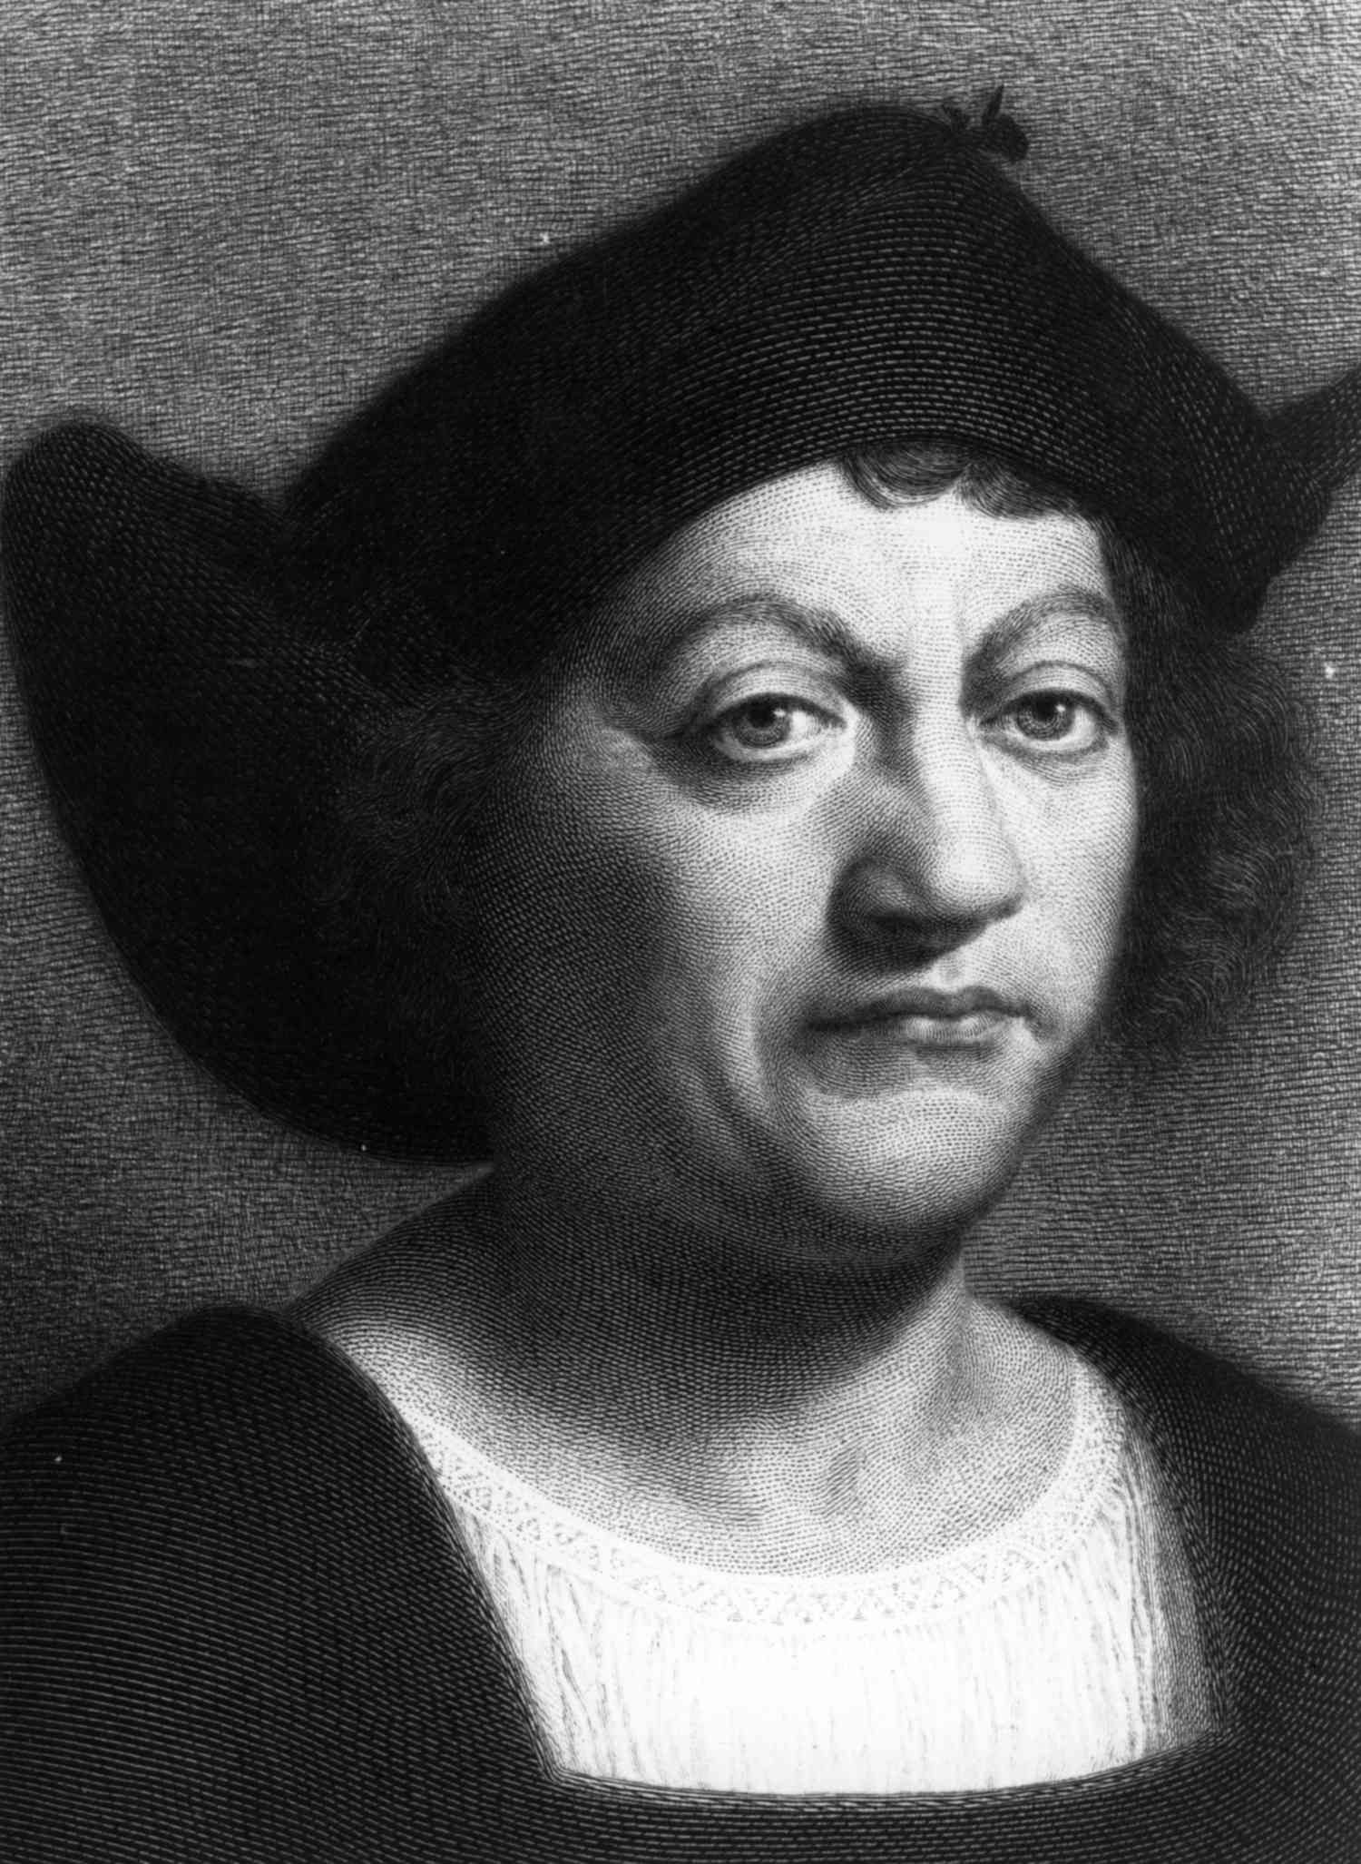
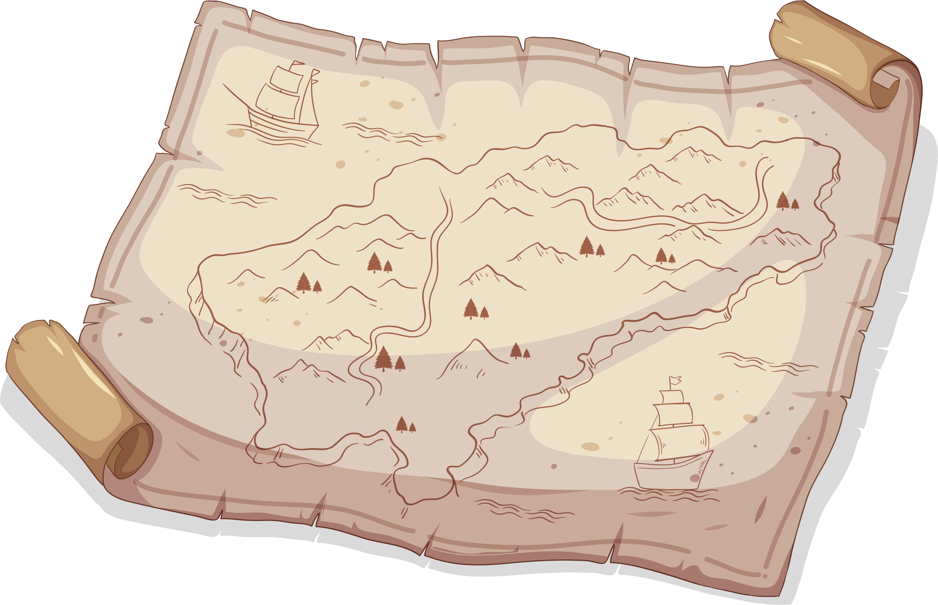
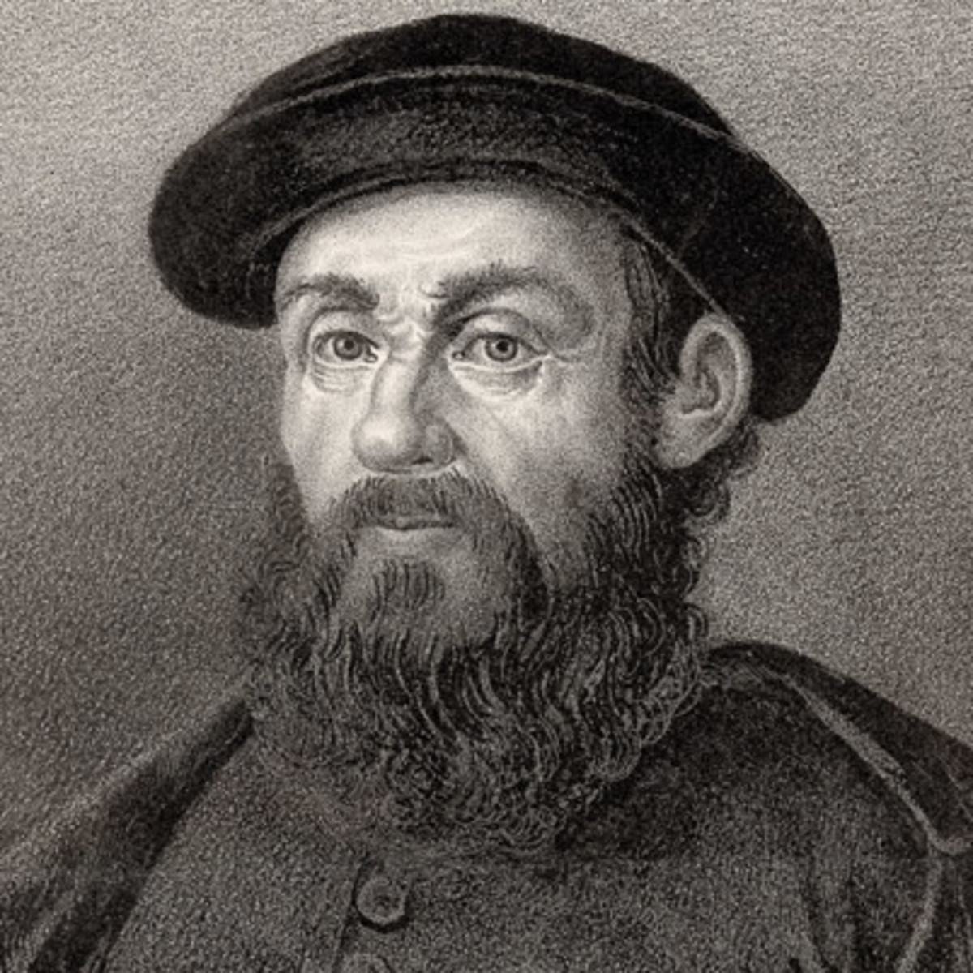
Maritime Exploration
Ferdinand Magellan
Christopher Columbus

Slide 3
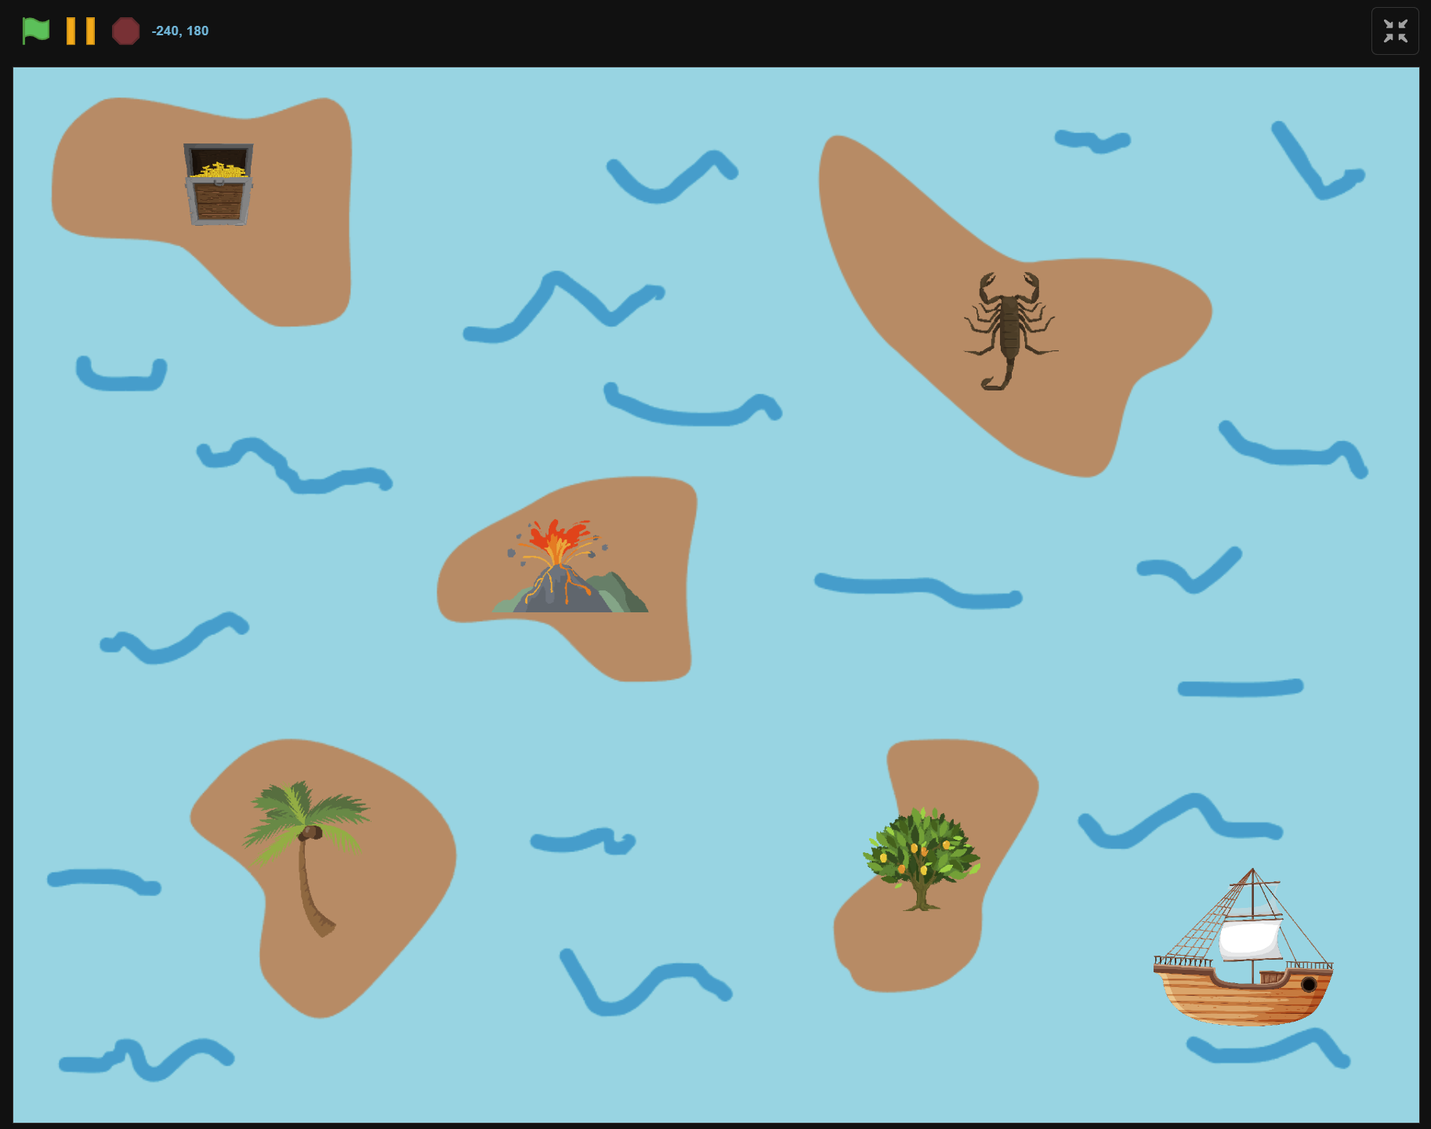
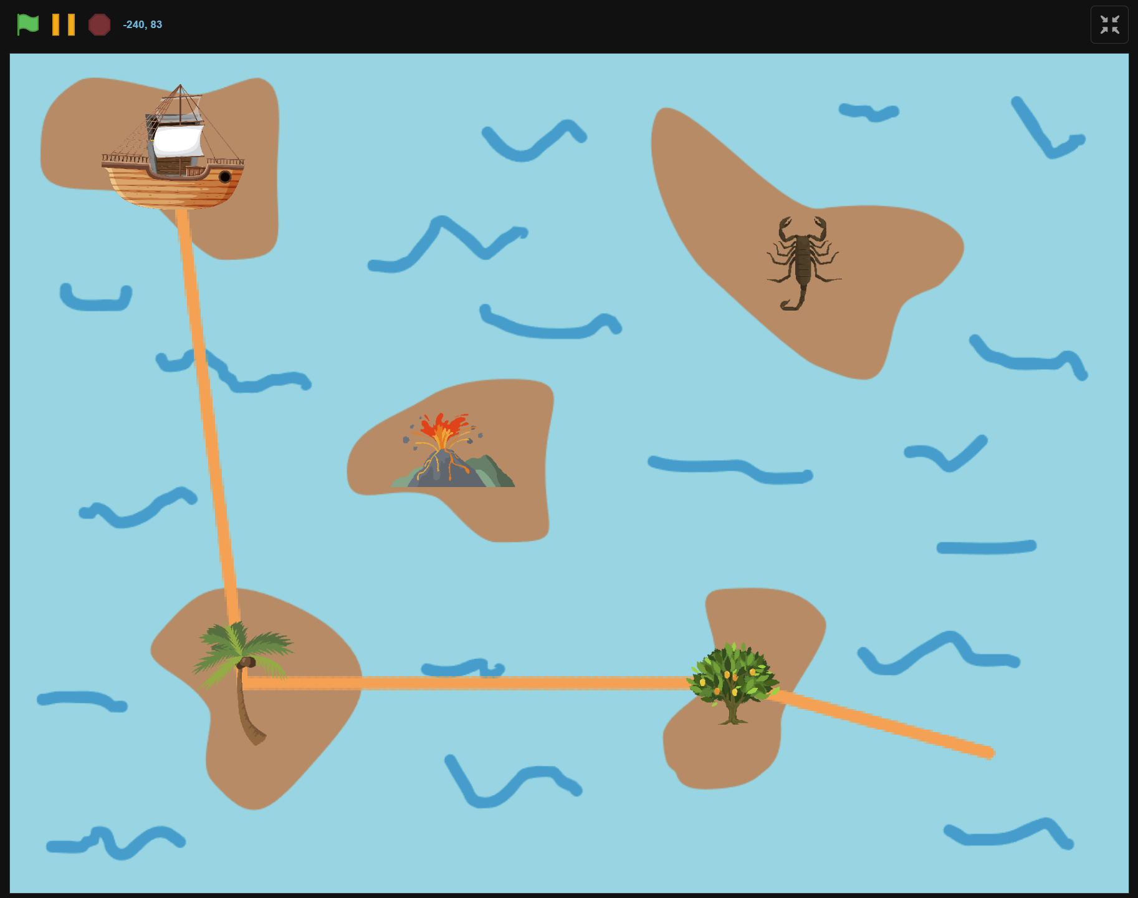
What we will Create…

Slide 4
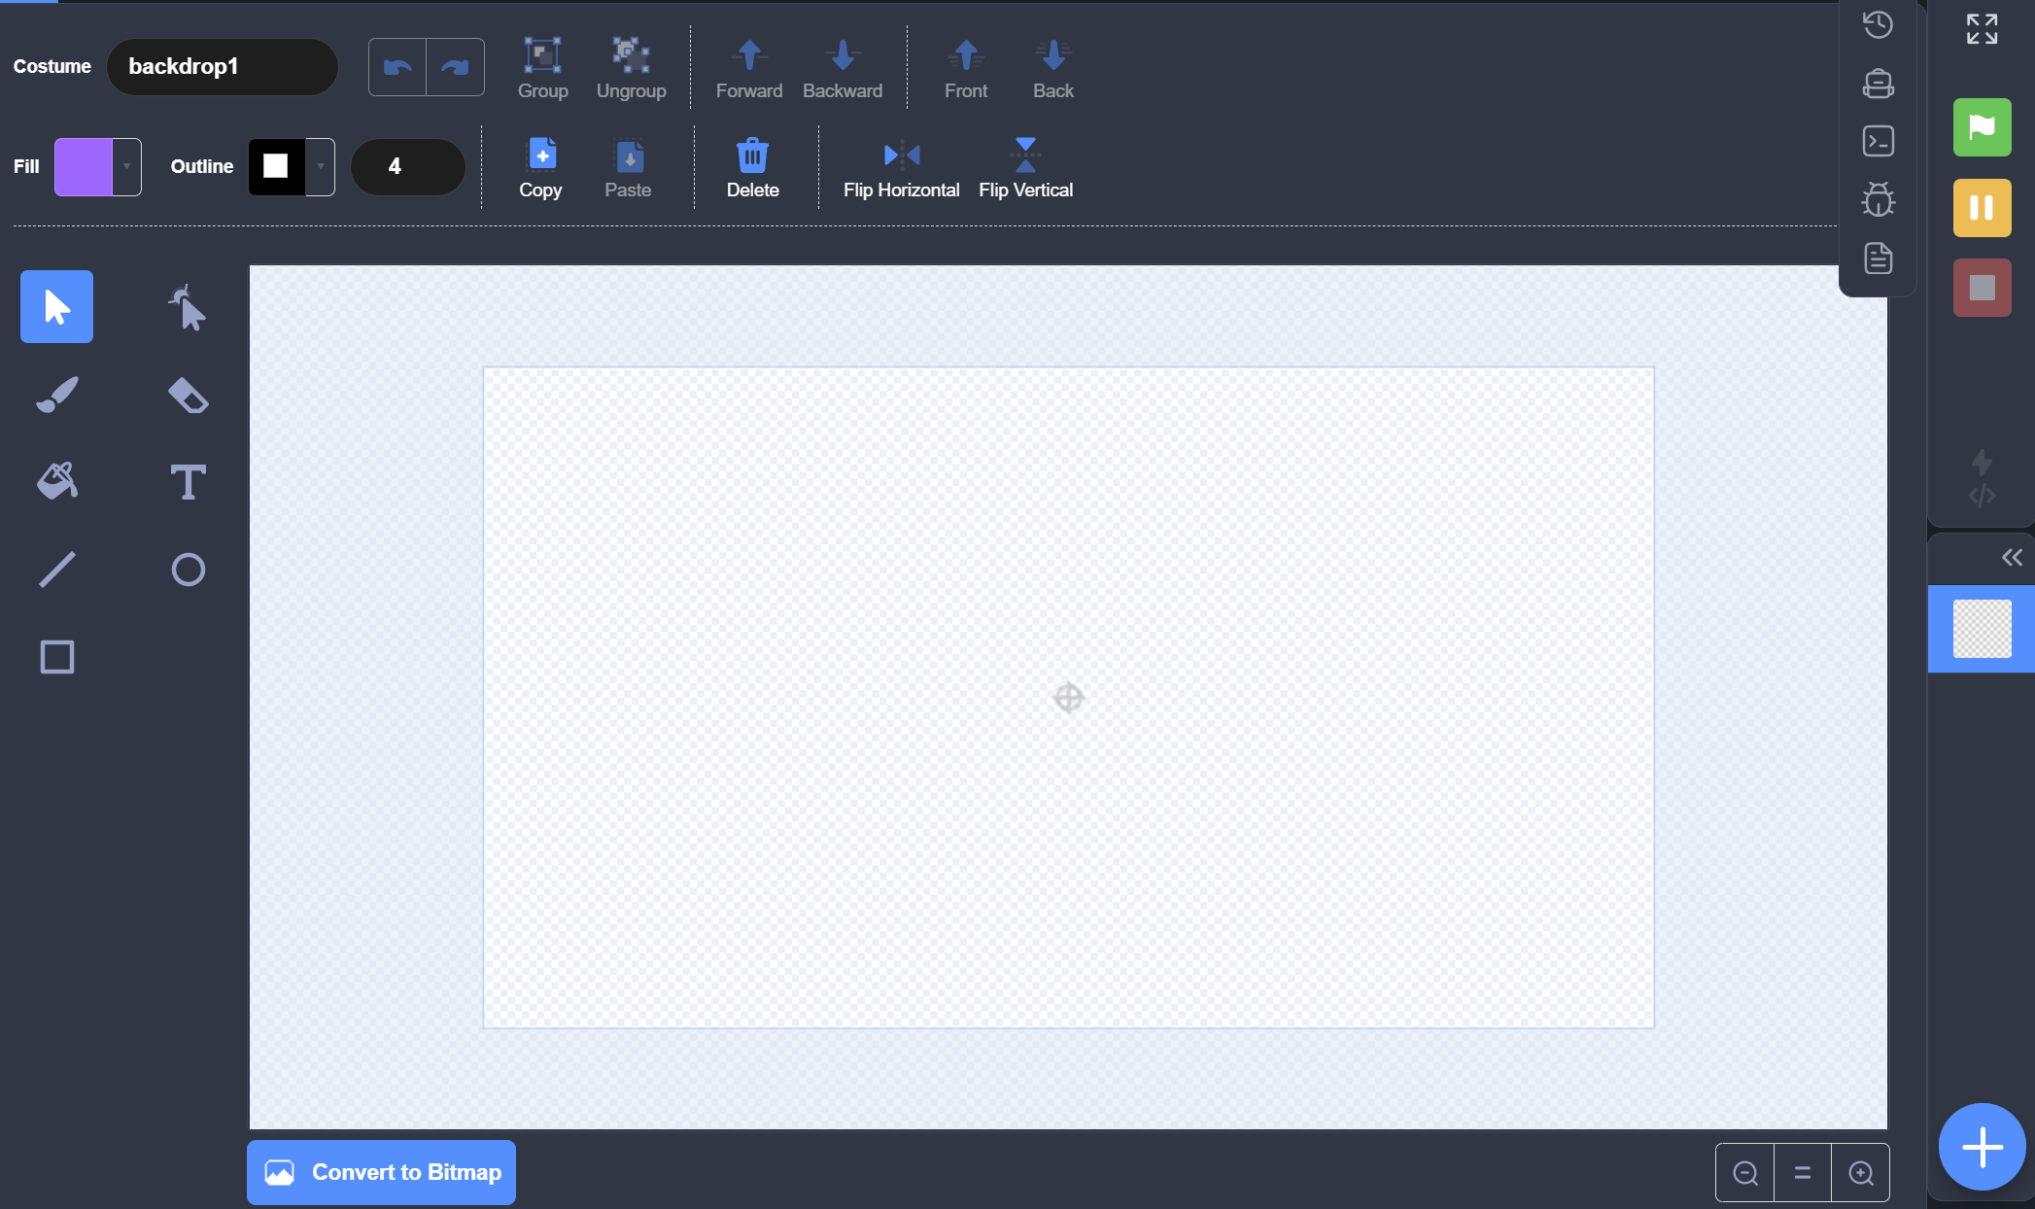
Backdrop editor

Slide 5


Canvas
Canvas
Change Canvas Size

Slide 6

Tool Box
Select
Reshape
Brush
Eraser
Fill
Text
Line
Circle
Rectangle

Slide 7
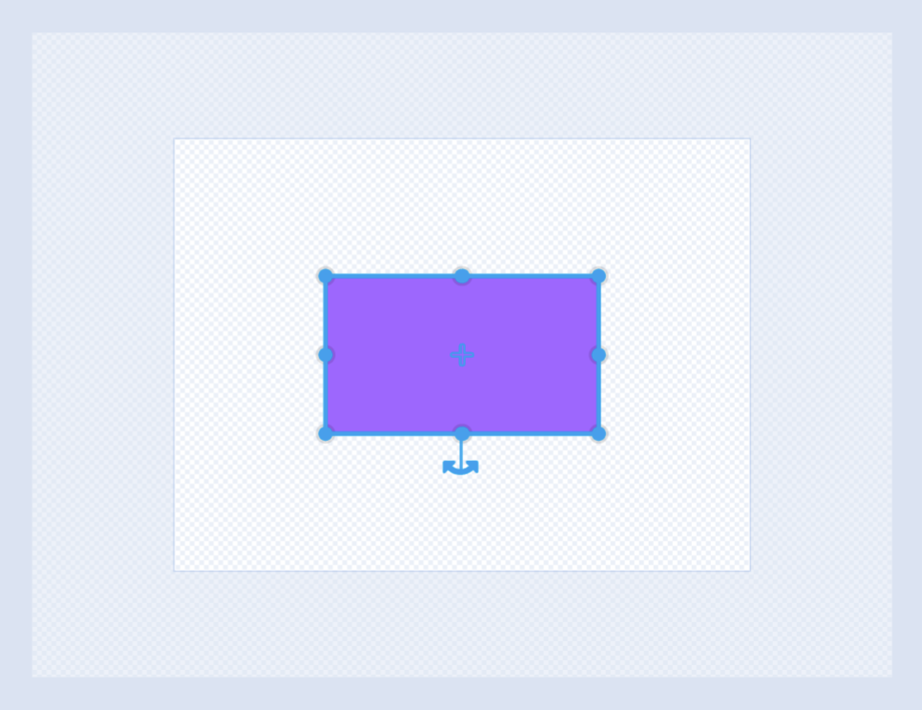

Draw Rectangle
Change Height
Change Width
Change Height and Width
Rotate
Rectangle

Slide 8
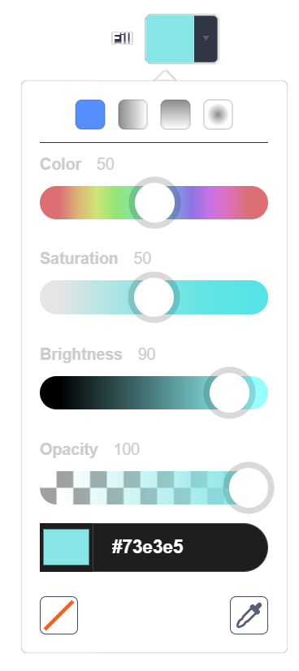

Draw Ocean
Color: 50
Saturation: 50
Brightness: 90
Opacity: 100

Slide 9
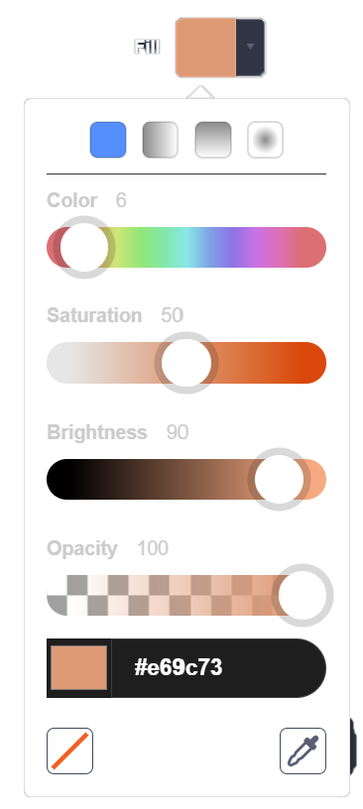
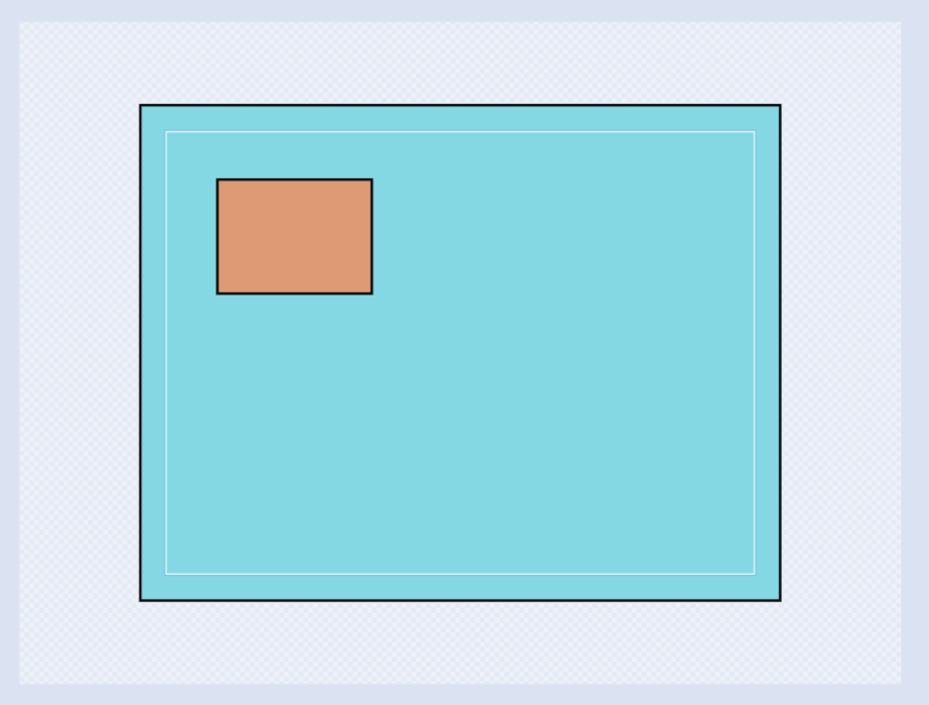
Draw Island
Color: 6
Saturation: 50
Brightness: 90
Opacity: 100

Slide 10
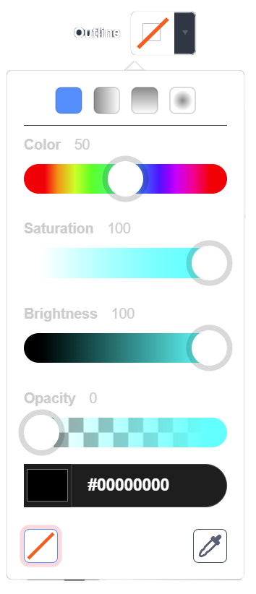
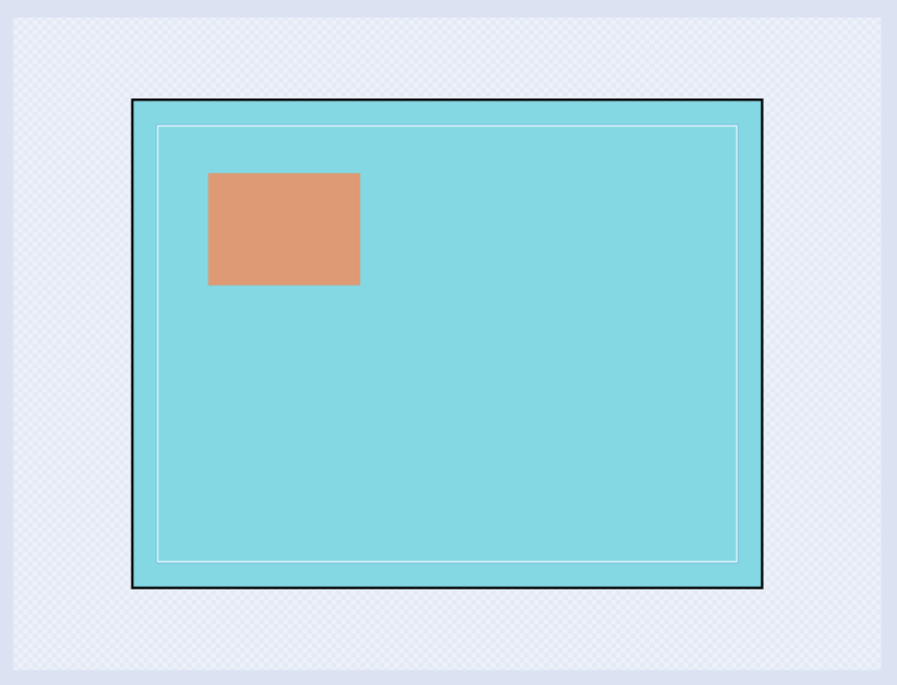
Remove outline
Remove Outline

Slide 11


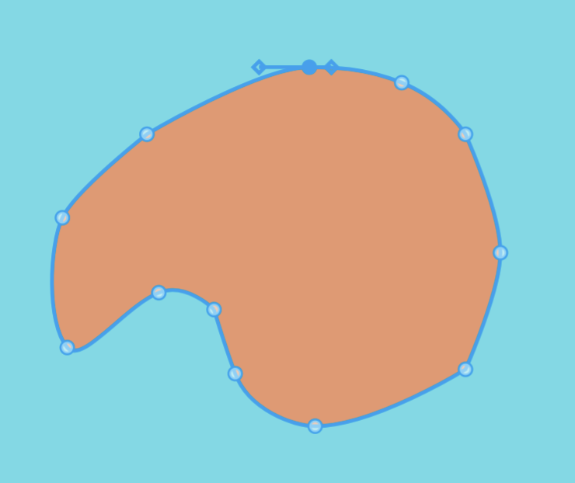
Reshape island

Slide 12
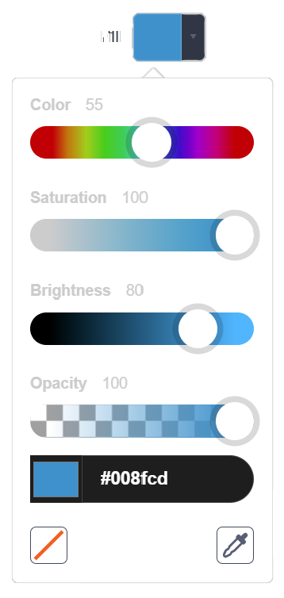


Draw Waves
Color: 55
Saturation: 100
Brightness: 80
Opacity: 100

Slide 13
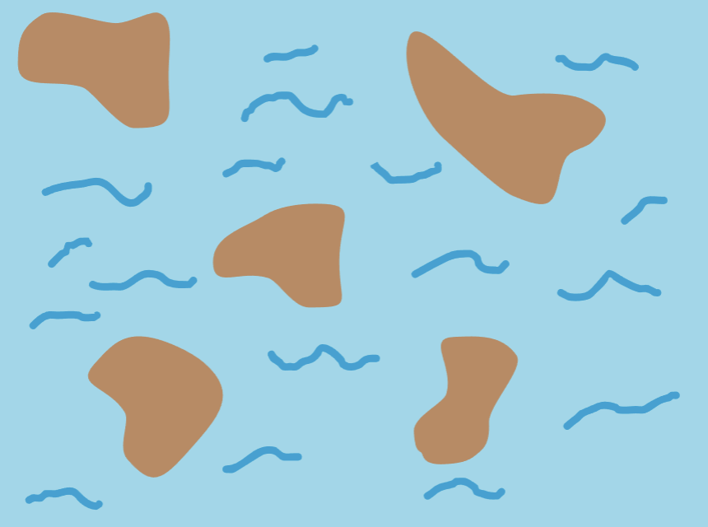
Finished backdrop

Slide 14
What we learnt…
Sprites can say or think…

Slide 15
Exercises
Have fun with some of the other effects
Try different sprites and backdrops
Say and think differently
Checkout costumes of other sprites
Invent your own way of communication!

Slide 16
Thank you and see you in the next lesson!

